Slide 1
Cryptograph
Grace L.jy
Grace L.jy©

Slide 2
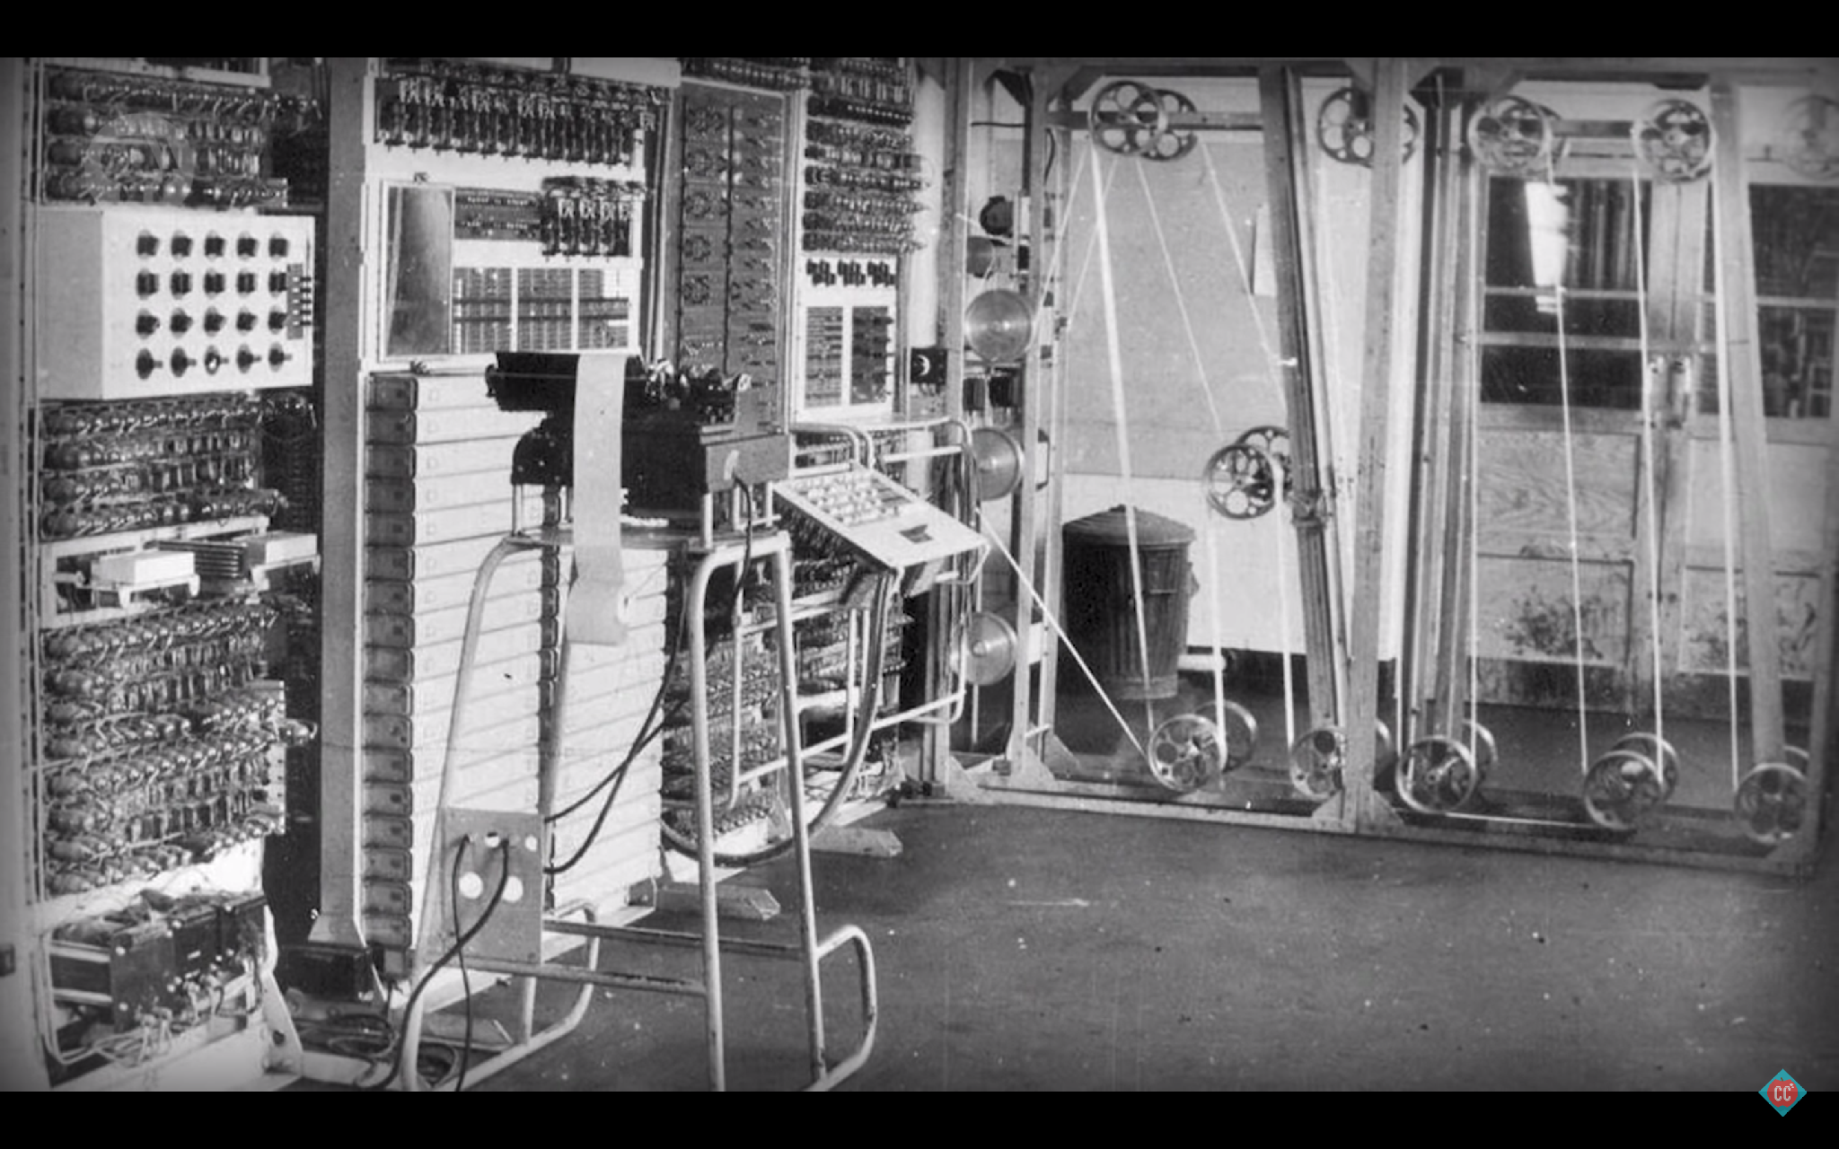

Then with the advent of computer, cryptography
moved from hardware into software
Grace L.jy©

Slide 3
DES
- Data encryption Standard
One of the earliest software ciphers to become widespread.
developed by IBM and NSA in 1977
used binary keys that were 56 bits long.
2 to the 56, it has about 72 quadrillion different keys.
Grace L.jy©

Slide 4
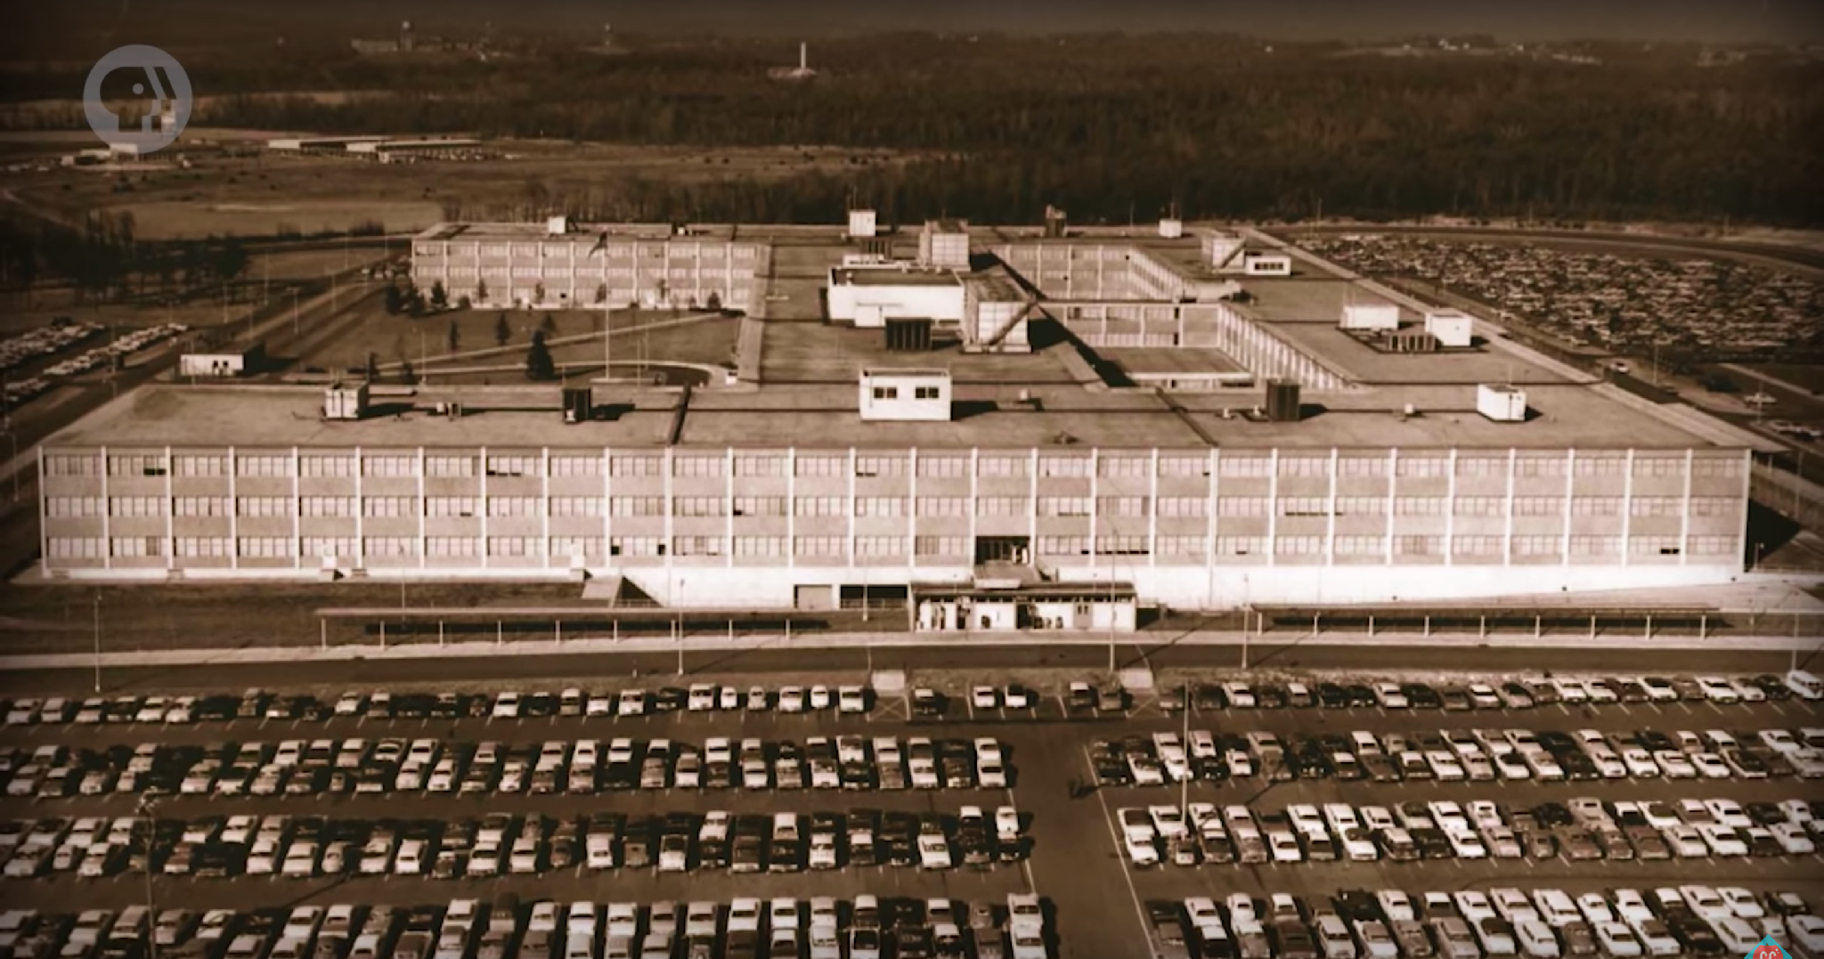
In 1977, nobody perhaps the NSA had enough computing power to brute-force all possible key.
Grace L.jy©

Slide 5
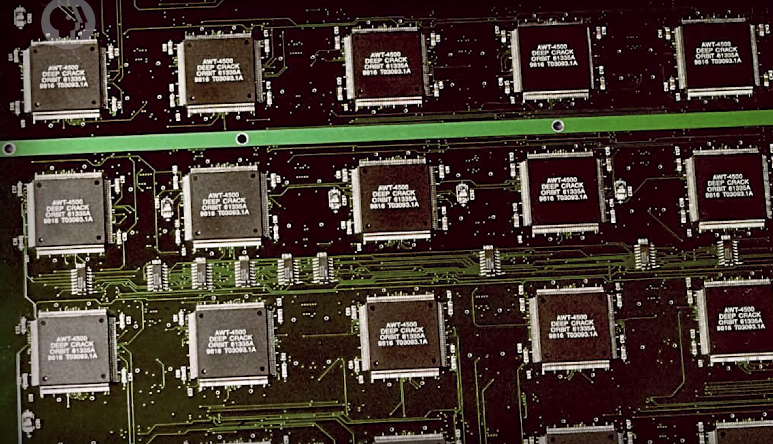
But by 1999, the computer could try every possible DES key in juts 2 days, rendering the cipher insecure.
Grace L.jy©

Slide 6
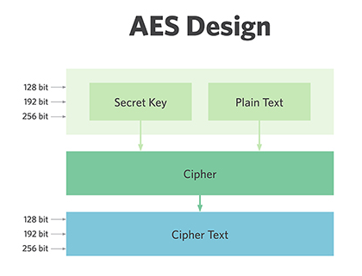
AES
In 2001, the Advances encryption standard was published
use much bigger keys, 128, 192 or 256 bits, making brute-force attacks much harder
For 128 bits key, you’d need trillions of years to try every combination even you used todays computer.
Grace L.jy©

Slide 7

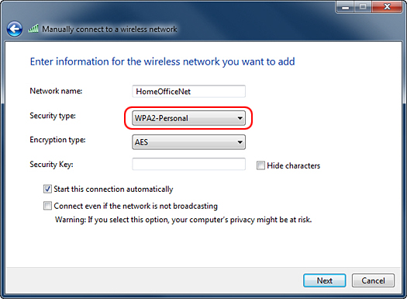
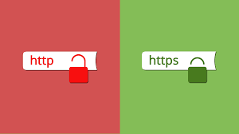
Grace L.jy©

Slide 8
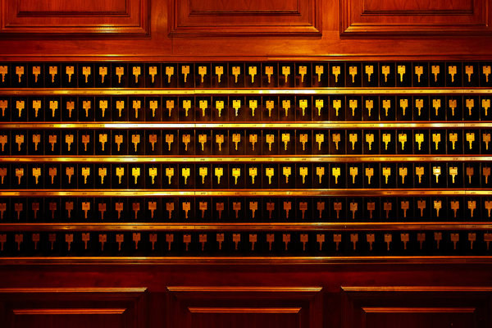

Grace L.jy©

Slide 9
key exchange
Let 2 computers agreed on a key with out ever sending one
We do this by one-way-function:
a mathematical operation that are very easy to do in one direction, but hard to reverse.
For example: “Diffie-Hellman key exchange”
Grace L.jy©

Slide 10
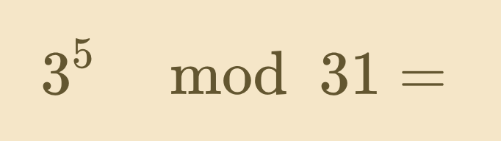
Diffie-Hellman key exchange
Modular exponentiation:
Taking a number A (the base) to the power of X (the exponent) and taking the remainder when dividing by a third number B (the modulus).
A^X mod B
For example: 3^5 modulo 31 = ?
3 to the 5th = 243, take the remainder when divided by 31, 243=7*31+26
3^5 modulo 31 = 26.
The hard part is: Figuring out the exponent given only the result and the base.
3^ ? modulo 31 = 26
we would have to test a lot of exponent to know the secret number.
3765434…855^ ? modulo 356790876…981 =
If we make these number bigger like hundreds of digits long, then finding the secret number is nearly impossible.
Grace L.jy©

Slide 11
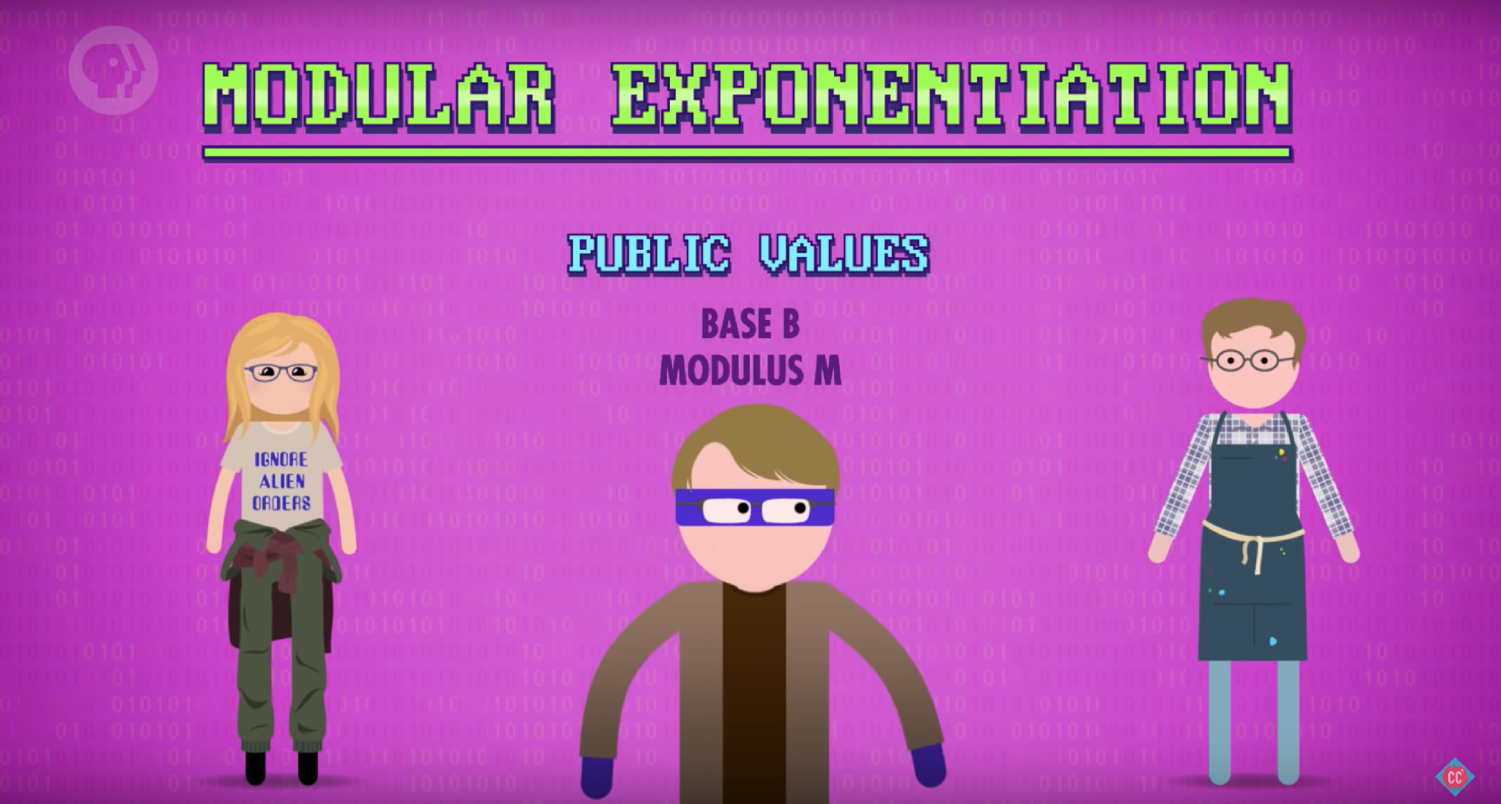
B^? Mod M
B^? Mod M
B^? Mod M
Grace L.jy©

Slide 12
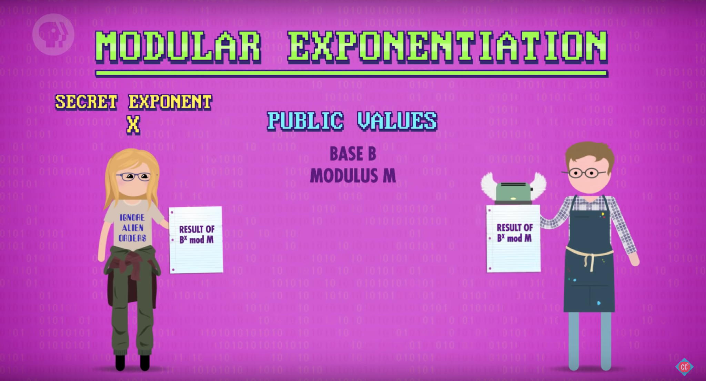
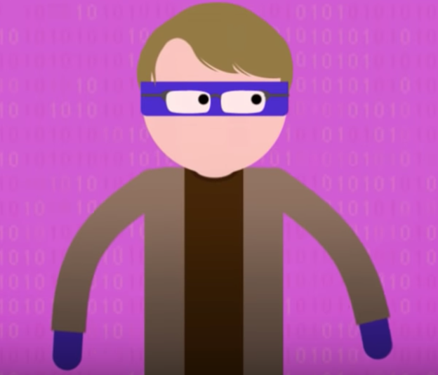
BigNumber1
BigNumber1
BigNumber1
B^X Mod M = BigNumber1
Grace L.jy©

Slide 13
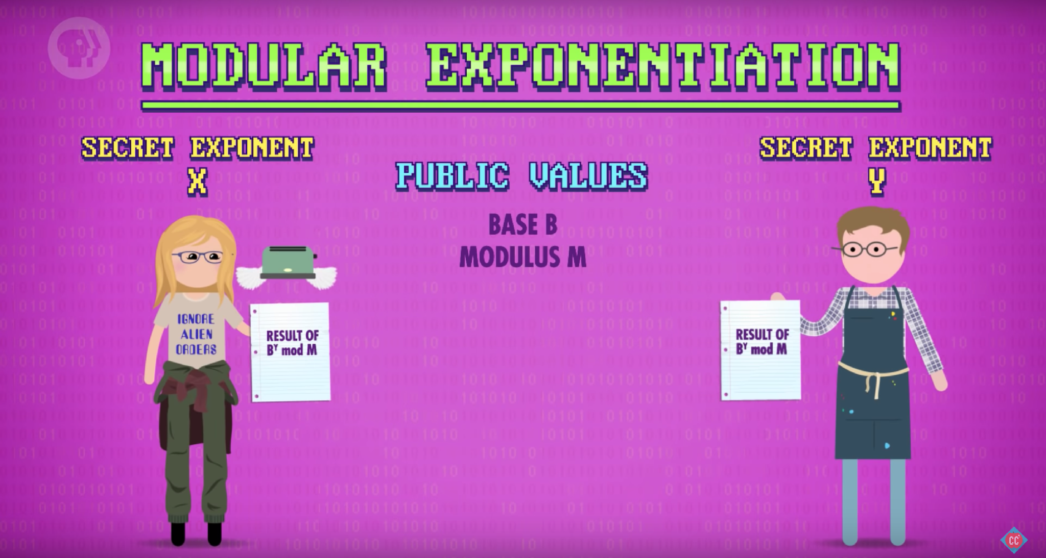
BigNumber2
BigNumber2
BigNumber2
BigNumber1
BigNumber1
BigNumber1
BigNumber1
B^Y Mod M = BigNumber2
Grace L.jy©

Slide 14
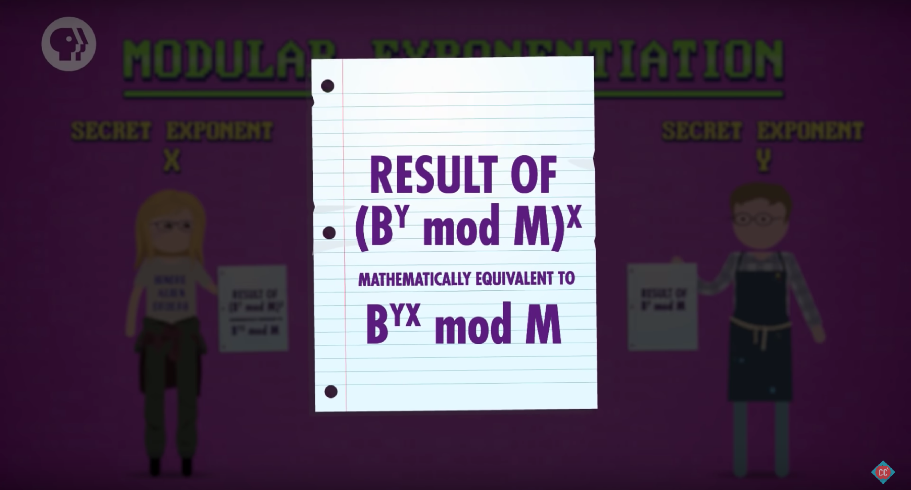
(B^Y mod M)^ X = BigNumber2 ^ X = BigNumber3
Grace L.jy©

Slide 15
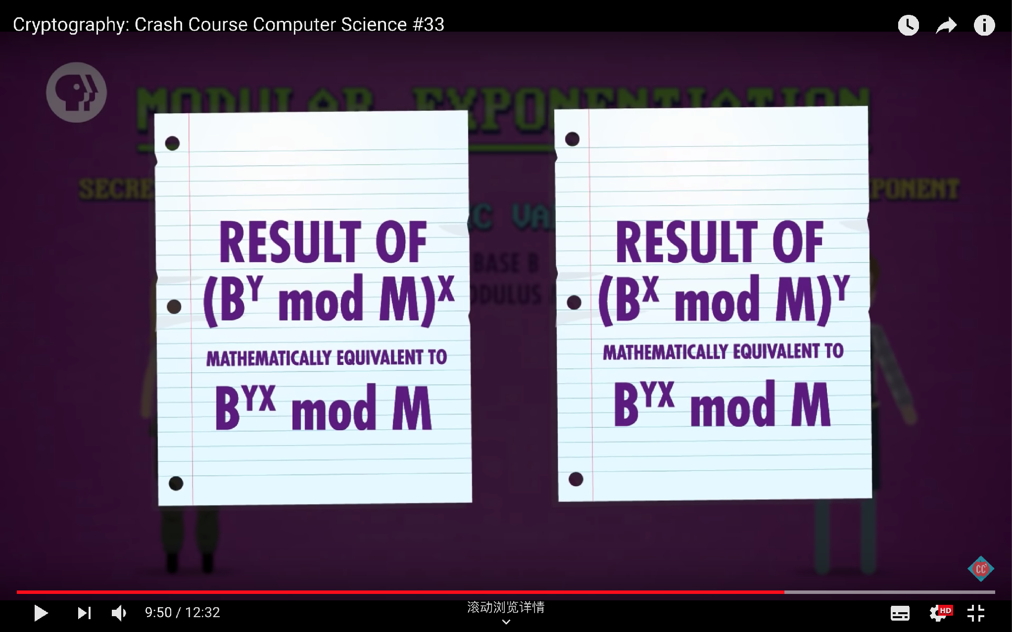
Grace L.jy©
Jenny
Bobby
Jenny: (Bobby result)^ X = (B^Y mod M)^ X = B^XY mod M. BigNumber2 ^ X = BigNumber3
Bobby: (Jenny result)^ Y = (B^X mod M)^ Y = B^XY mod M. BigNumber1 ^ Y = BigNumber3

Slide 16
Grace L.jy©
BigNumber2
BigNumber2
BigNumber2
BigNumber1
BigNumber1
BigNumber1
“BigNumber1” “BigNumber2” = B^ ? Mod M. Hackers has no way to figure out ?(X/Y) and get BigNumber3.

Slide 17

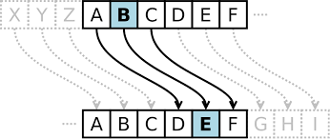
“Diffie-Hellman key exchange” is one method for establishing a shared key,
The shared key that people used to encrypt and decrypt the message are called symmetric key
The Caesar cipher, enigma and AES are all symmetric encryption,
Grace L.jy©

Slide 18
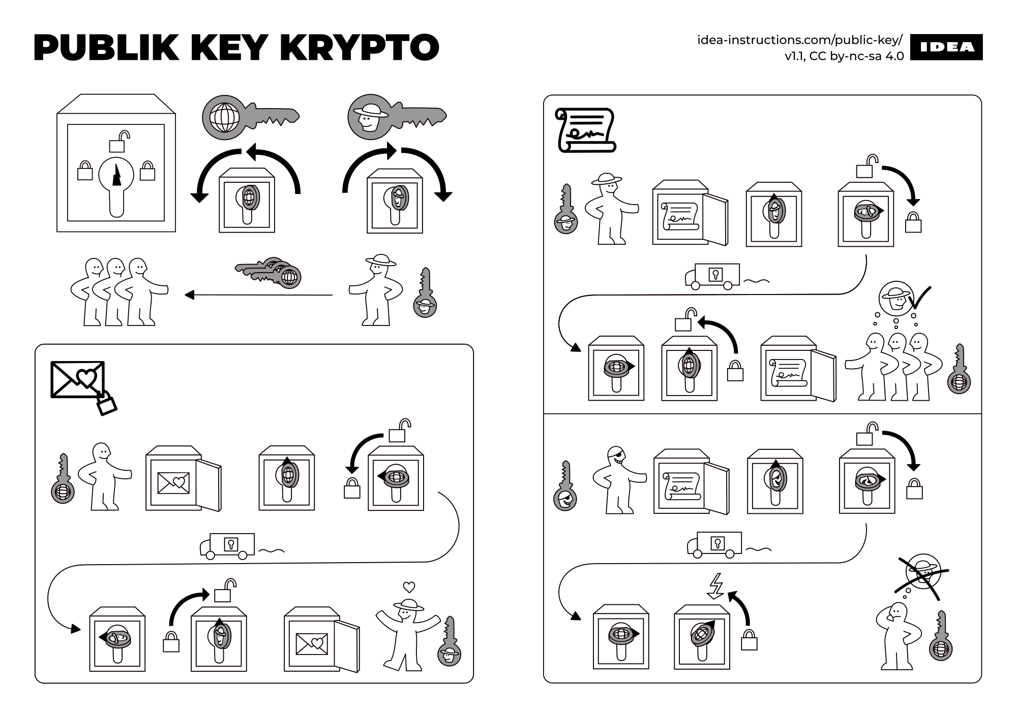
Grace L.jy©

Slide 19
BigNumber2
?
BigNumber2
BigNumber1
BigNumber1
?
BigNumber1
Grace L.jy©

Slide 20
Grace L.jy©

Slide 21
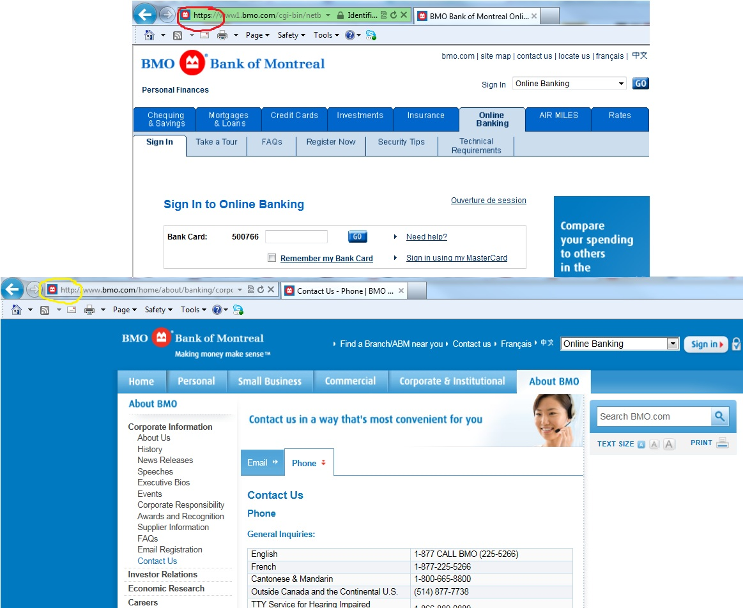
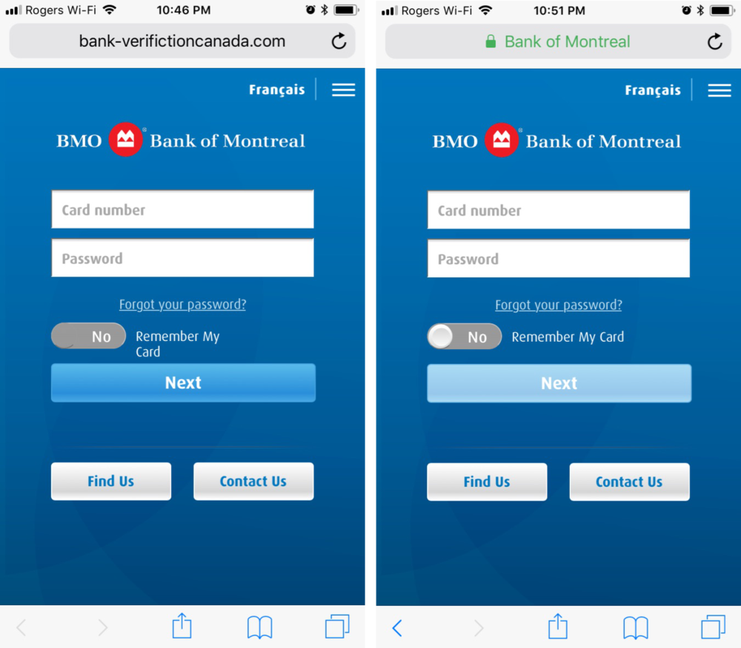
little padlock icon — public key cryptography - encrypted communication - key exchange — secret temporary key - symmetric encryption — protect all the back-and-forth communication from prying eyes.
Grace L.jy©

Slide 22
Thank you
Grace L.jy©

